Slide 1

Filling in missing series information
Graeme Williams
carryonwilliams@gmail.com
@lagbolt

Slide 2
Summary
Compare series information from:
1,942 MARC records
books with subject = science fiction or fantasy
100 $a, 245 $a and 490 $a if present
Internet Science Fiction Database (isfdb.com)
Downloaded copy of database
Searched for series information using author + title
Goodreads and Novelist
Called internet API
Searched for series information using author + title

Slide 3
The process – part 1
645 records,
no 490,
No series
information in ISFDB
1200 records include 490 field
97 records, no 490
BUT
series info
In ISFDB
1,942 records in total

Slide 4
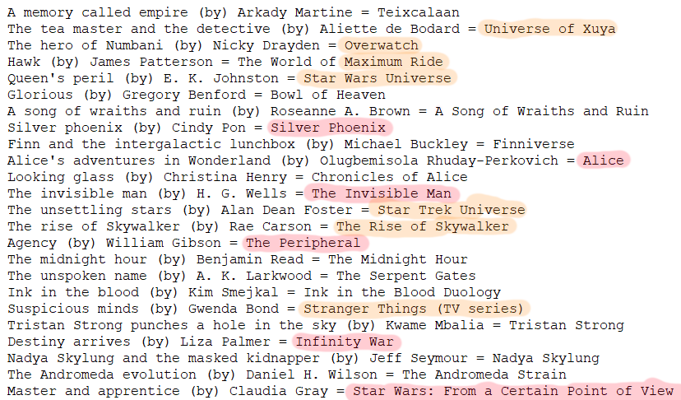
Hand-checking …

Slide 5
The process – part 2
The values returned by ISFDB weren’t sufficiently accurate, but perhaps it is useful as a filter.
As before, take the author and title from the 97 records and:
Obtain series information, if any, from Goodreads using their public network API
Obtain series information, if any, from Novelist using an internal OPAC API
Compare the results from ISFDB, Goodreads and Novelist

Slide 6
Summary of results
Remember that all 97 records matched series information in ISFDB because that’s how we defined this set of records.
Of the 97 records …
82 records matched series information in Goodreads
→ 15 records had series information in ISFDB but not Goodreads
7 records matched series information in Novelist
You can find the results at: https://github.com/lagbolt/catalog-errors/tree/master/files

Slide 7
The series data from Goodreads
The series data that was present (82 titles) was correct, except:
Some “series” data should have been subject headings
E.g., “Xuya (fictional universe)”, “Maximum Ride (videogame)”
Which, btw, are not present in LCSH / LCNAF
Something called “Star Wars Disney Canon Novel”
The series data that was missing (15 titles) from Goodreads but present in ISFDB was interesting:
4 correct (including one sequel coming out in 2023!)
3 “world of …”
1 publisher imprint
7 incorrect

Slide 8
Conclusions
Data from ISFDB is useful as a filter
The downloadable database makes it easy to use
Novelist didn’t provide any help at all
Goodreads data is very good
It could be used as is, depending on your attitude to introducing errors
The combination of ISFDB and Goodreads is
EFFICIENT AND EFFECTIVE

Slide 9
The End
Code is available:
seriescheck.py at
https://github.com/lagbolt/catalog-errors
Questions -> carryonwilliams@gmail.com

